Slide 1

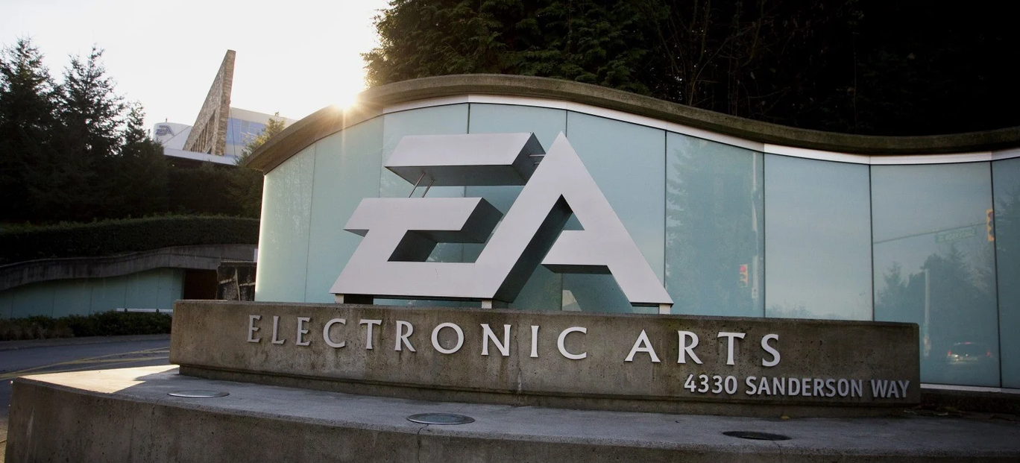
FINANCIAL
ANALYSIS
Group 10

Slide 2

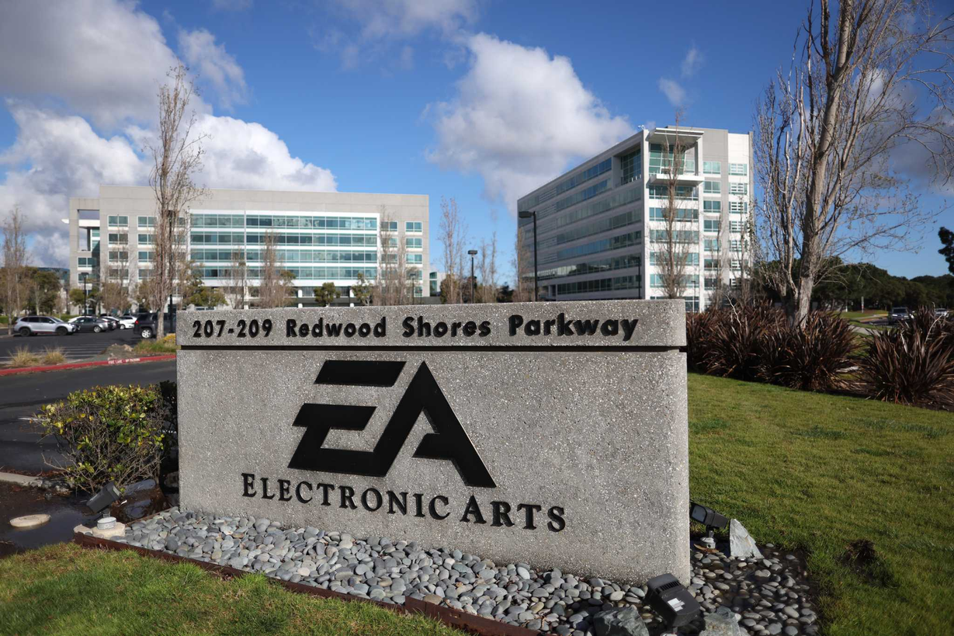
ELECTRONIC ARTS
American Video game Developer for PCs and Various Consoles.
Established in 1982.
Went Public in 1989.
Headquartered in Redwood City, CA.

Slide 3





CURRENT PRODUCTS
Intellectual Properties
Apex Legends
FIFA
Madden
Need for Speed

Slide 4
MERGERS & ACQUISITIONS
1991
1995
1997
2007
Distinctive Software
(Test Drive)
Bullfrog Productions
(Dungeon Keeper Trilogy)
Maxis
(The Sims and Sims City Series)
BioWare
(Dragon Age and Mass Effect)
2011
2017
2021
PopCap Games
(Plants vs. Zombies)
Respawn Entertainment
(Apex Legends)
Glu Mobile
(Deer Hunter Franchise)

Slide 5
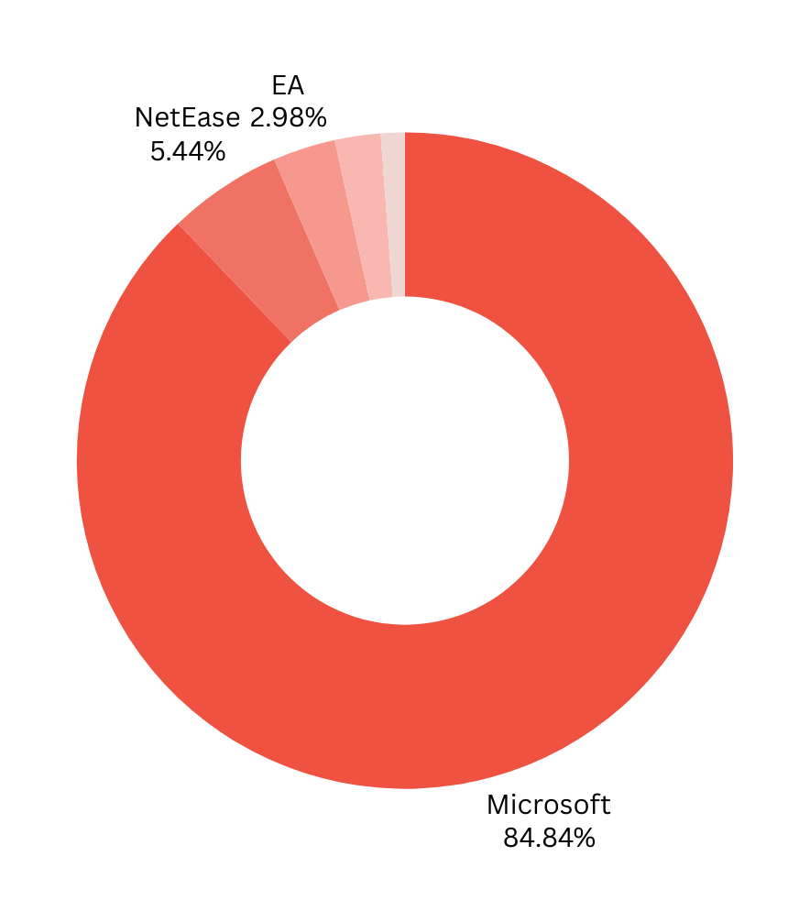





INDUSTRY COMPETITORS
Software & Programming Sector
Market Share - Q4 2023
ACTIVISION BLIZZARD (MICROSOFT)
NETEASE
ELECTRONIC ARTS (EA)
TAKE-TWO INTERACTIVE
ROBLOX CORPORATION

Slide 6
FINANCIAL RATIOS
PROFITABILITY RATIOS | PROFITABILITY RATIOS
Gross Profit Margin | 76%
Operating Profit Margin | 44%
Return on Assets | 6%
Return on Equity | 11%
Return on Sales | 10.8%
Return on Investment | NA
LIQUIDITY RATIOS | LIQUIDITY RATIOS
Current Ratio | 1.21
Quick Ratio | 1.21
Cash Ratio | 0.74
DEBT-TO-EQUITY RATIO | 0.26
P/E RATIO | $45.75
DIVIDENDS PAYOUT RATIO | 26.2%
ORGANIZATION’S SUSTAINABLE GROWTH RATE | 8.1%

Slide 7
CAPITAL ASSET PRICING MODEL
CAPM - The Risk-Adjusted Rate or Return
Beta (B): 0.86
Risk Free Rate of Return (Rf): 4.2%
Market Returns (Rm): 10.9%
CAPM = Rf + B x (Rm - Rf) = 10%
Considering Market Risks, Investors can expect a return of 10%

Slide 8
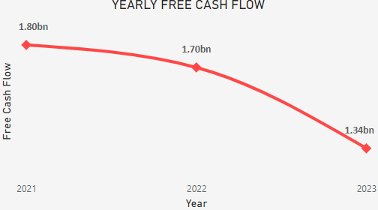
FREE CASH FLOW
Surplus after covering Operational Costs.
Decreasing over time.
Could potentially limit the company’s capacity to grow.
Analyse to ensure sustainable financial health.

Slide 9
WEIGHT AVERAGE
COST OF CAPITAL
WACC - Expected Returns to Satisfy Investors
Cost of Equity (Re): 10%
Cost of Debt (Rd): 3.2%
Weight of Equity (We): 95%
Weight of Debt (Wd): 5%
Tax Rate (T): 28.5%
WACC = We x Re + (Wd x Rd x (1 - T)) = 9.6%
EA is expected to generate a return of at least 9.6% or more to satisfy Investors and Debtors

Slide 10
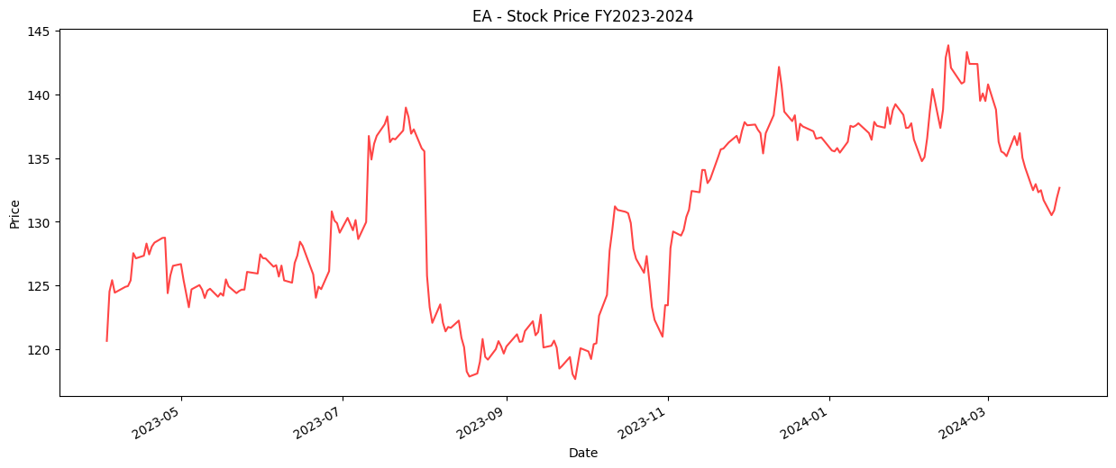
STOCK PRICE ANALYSIS
FY 2023-2024

Slide 11
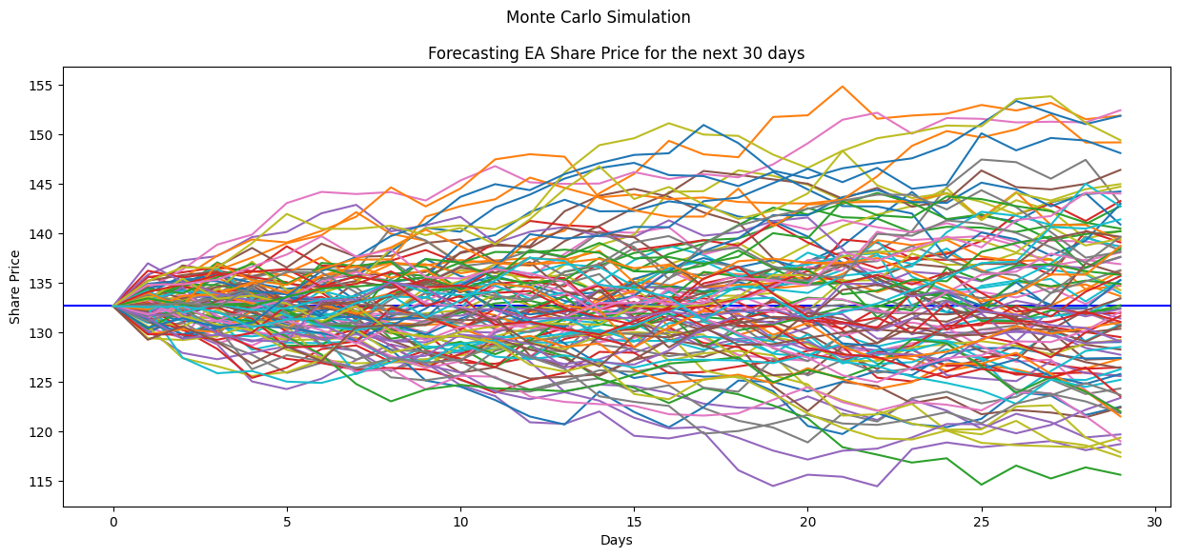
MONTE CARLO SIMULATION

Slide 12
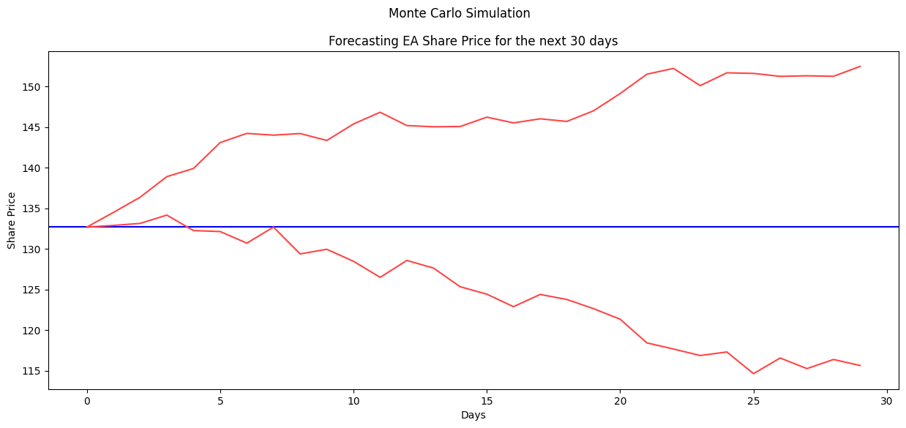
MONTE CARLO SIMULATION

Slide 13
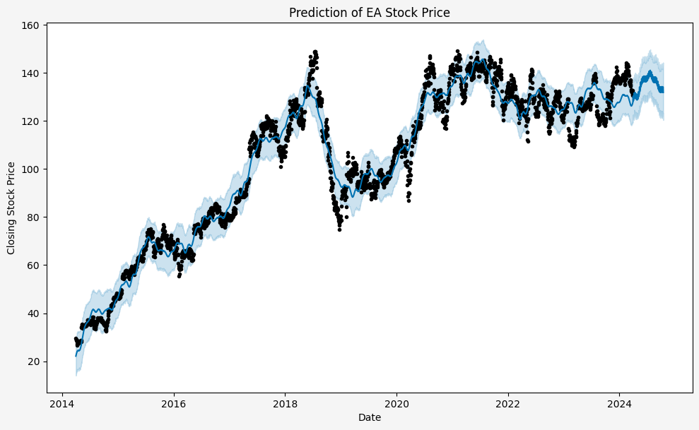
FB PROPHET FORECASTING

Slide 14

INSIGHTS &
RECOMMENDATIONS
Financial Foundation: EA demonstrates robust liquidity, profitability, and a low debt-to-equity ratio, indicating a strong financial base.
Operational Efficiency: All profitability ratios highlight healthy and efficient operations, showcasing effective resource utilization.
Growth Potential: The Sustainable Growth Rate of 8.1% suggests a moderate expansion capacity for the company.

Slide 15
INSIGHTS &
RECOMMENDATIONS
Return Rate: The CAPM indicates a 10% return rate, considering the company's risk profile and market performance.
Cash Flow Concern: Free Cash Flow has seen a year-on-year decrease, signaling a need for caution and further analysis.
Forecast and Simulations: The FB Prophet Forecast model predicts modest yet stable growth, while Monte Carlo Simulations show an overall positive trend with some volatility.

Slide 16
ELECTRONIC ARTS
We Recommend
HOLD!!!

Slide 17
THANK YOU

